Slide 1
National Resilience Platform: Mobilizing India's Tech Talent for Crisis Solutions and National Development.
PIP2001 Capstone Project
Review-4
Batch Number: 216
20211CSE0653 | DHEERAJ
20211CSE0643 | SANJAY
20211CSE0649 | MAHESHGOUDA
20211CSE0639 | SACHIN
Roll Number | Student Name
Under the Supervision of
Dr.Iqbal Gani Dar
Assistant Professor
School of Information Science
Presidency University
Name of the Program: CSE
Name of the HoD: Dr. Blessed Prince P/Dr. Robin Rohit/Dr.Asif Mohammed H.B
Name of the Program Project Coordinator: Mr. Amarnath J.L & Dr. Jayanthi. K.
Name of the School Project Coordinators: Dr. Sampath A K / Dr. Abdul Khadar A / Mr. Md Ziaur Rahman

Slide 2
Introduction
This project aims to create two innovative platforms that harness the power of India's vast IT talent pool to address critical national needs.
The first platform is an e-commerce solution designed to support disaster-affected markets like the 500-year-old Ima Market in Manipur, allowing vendors to continue their businesses online while utilizing existing delivery infrastructure such as India Post.
The second platform is an open-source collaboration hub, enabling skilled IT professionals to contribute code, algorithms, or financial resources to important national systems and applications. These platforms aim to foster resilience, economic recovery, and collective problem-solving on a national scale.

Slide 3
Literature Review
The case of Ima Market in Manipur aligns with this, where a digital platform could help women vendors maintain their livelihoods post-disaster.
On the other hand, open-source collaboration platforms empower IT professionals to contribute their skills to national projects, addressing the need for scalable solutions.
The use of cloud infrastructure, containerization, and progressive web apps (PWA) enables rapid deployment and real-time functionality, as supported by several studies on technology-driven interventions. Examples from disaster recovery efforts in Japan and Nepal further validate the effectiveness of such platforms in promoting resilience. However, challenges such as digital literacy and security concerns must be addressed for success.

Slide 4
Existing method Drawback
Traditional Marketplace Dependency:
Physical markets, like Ima Market, rely solely on face-to-face transactions. In cases of natural disasters (e.g., earthquakes), these markets are severely disrupted, leading to months of economic inactivity and financial hardship for vendors.
Drawback: No digital presence means vendors lose their primary source of income, and recovery depends entirely on rebuilding the physical infrastructure, which can take time and resources.

Slide 5
Existing method Drawback
Limited IT Contribution Platforms:
Although India has a vast IT workforce, there is no centralized platform that enables IT professionals to contribute their skills toward national projects or disaster recovery efforts. Current platforms focus on corporate or commercial software development, leaving little room for national or social contributions.
Drawback: IT professionals with skills to contribute lack a structured and accessible system to offer their expertise, which limits innovation and collaboration on critical national projects.

Slide 6
Proposed Method
Project repository with a list of national projects in need of IT solutions.
Version control integration (e.g., GitHub/GitLab) to manage contributions and track project progress.
Collaboration tools to enable communication between developers and project leads.
Mobile-friendly interface with simple navigation for easy use by individuals with low digital literacy.
Integration with India Post or other local delivery systems to manage logistics for product delivery.
Cloud storage for hosting vendor products and contributor projects securely.

Slide 7
Objectives
Develop an E-Commerce Platform: Create a digital marketplace for disaster-affected vendors to sell products online, ensuring continued income.
Use Existing Delivery Infrastructure: Leverage logistics support like India Post to manage product deliveries for the platform.
Engage IT Talent: Enable India’s IT workforce to support national systems through software development and financial contributions.
Support Economic Resilience: Provide immediate financial relief to communities by offering digital solutions during crises.
Encourage Collaborative Innovation: Foster national project development through IT collaboration tools and version control systems.

Slide 8
Methodology/Modules
E-Commerce Platform Development:
Module 1: Vendor Registration and Product Listing: Create a user-friendly interface for vendors (e.g., Ima Market vendors) to easily register and list their products. Include mobile support for vendors with low digital literacy.
Module 2: Integration with India Post for Delivery: Set up logistics integration with India Post or other delivery services to manage product shipping and tracking.
Module 3: Payment Gateway Integration: Implement secure payment gateways (e.g., UPI, Paytm) to facilitate online transactions between vendors and customers.
Module 4: Customer Portal: Design a simple and responsive customer interface for browsing, purchasing, and tracking orders.

Slide 9
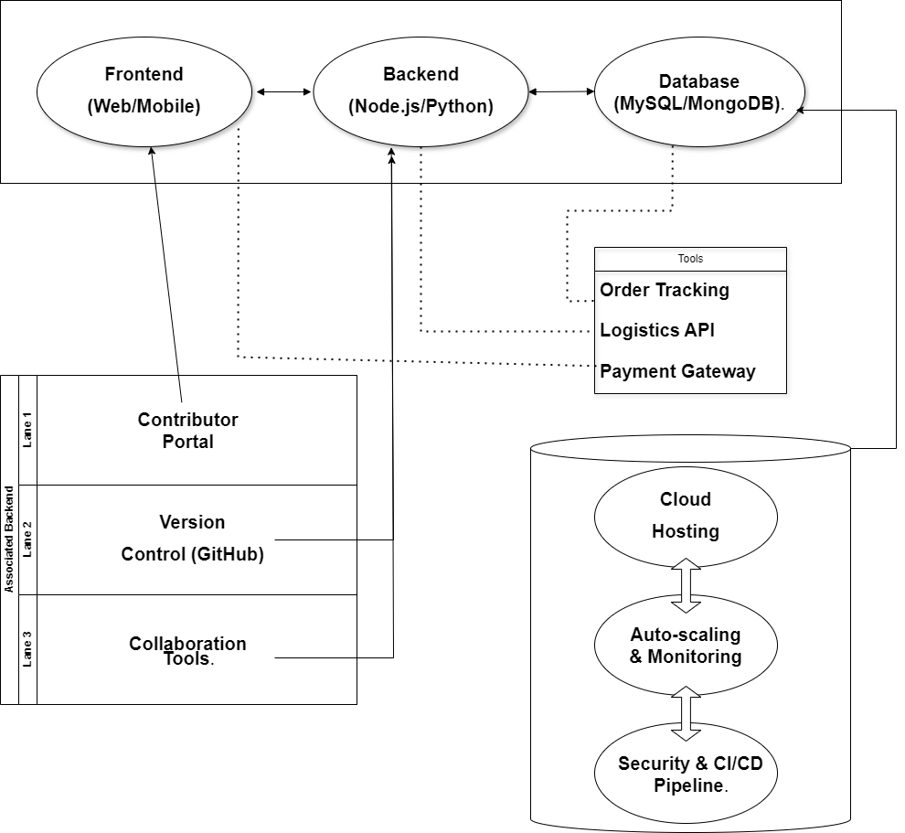
Architecture

Slide 10
Hardware/software components
Hardware Components :
Server: Intel Xeon/AMD EPYC, 16GB RAM, 1TB SSD.
Client Devices: Smartphones, tablets, or computers for users/vendors.
Networking: High-speed routers, switches, and firewall for secure communication.
Cloud Infrastructure: AWS/Google Cloud for scalable hosting.
Software Components :
OS: Linux (Ubuntu) or Windows Server.
Web Server: Apache or Nginx.
Programming: Python (Flask/Django) or Node.js for backend; React.js/Angular for frontend.
Database: MySQL or MongoDB..

Slide 11
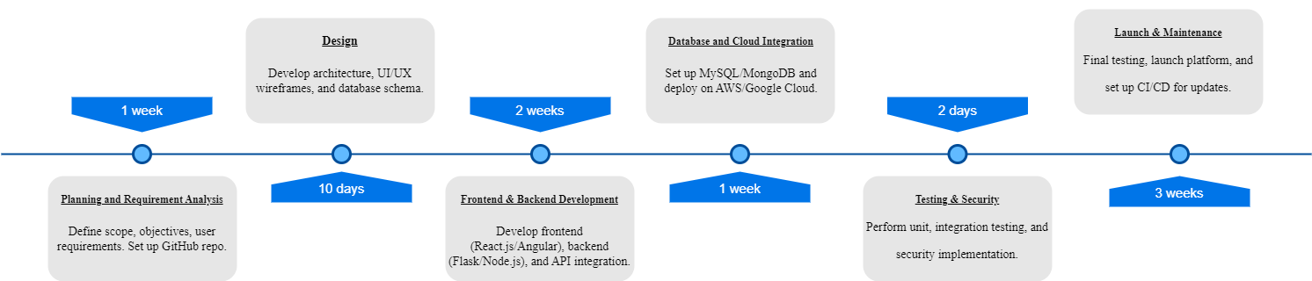
Timeline of Project

Slide 12
Expected Outcomes
Functional E-Commerce Platform for vendors to continue business online.
Open-Source Collaboration Hub for IT professionals to contribute.
Wider Reach for Vendors, ensuring consistent income.
Community Contribution to national importance projects.
Faster Market Recovery after crises.
Scalable and Secure Platform with cloud hosting.
Efficient Logistics Integration for order delivery.

Slide 13
Conclusion
The proposed e-commerce platform and collaboration hub aim to empower local vendors, such as those in Ima Market, by providing an online marketplace during disruptions. By leveraging India’s vast IT talent, the project fosters community-driven development of national importance systems. The platform offers scalability, security, and a seamless integration with logistics services, ensuring quick recovery and continued economic activity for vendors. This initiative not only strengthens the digital economy but also promotes resilience in times of crisis.

Slide 14
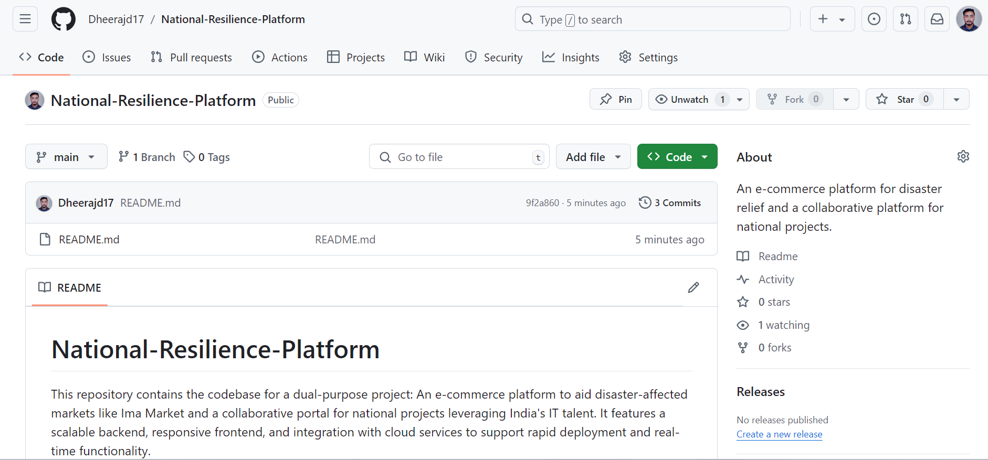
Github Link
Github Link - National Resilience Platform (GitHub Access)

Slide 15
References
[1] B. Trinkenreich, I. Wiese, A. Sarma, M. Gerosa, and I. Steinmacher, “Women’s participation in open source software: A survey of the literature,” ACM Trans. Softw. Eng. Methodol., vol. 31, no. 4, 2022. DOI: 10.1145/3510460.
[2] C. C. Okoye, E. Nwankwo, F. Usman, and N. Z. Mhlongo, “Seduring financial data storage: A review of cybersecurity challenges and solutions,” Int. J. Sci. Res. Arch., vol. 11, no. 1, Mar. 2024. DOI: 10.30574/ijsra.2024.11.1.0267.
[3] K. Clement and M. Hansen, “Financial incentives to improve environmental performance: A review of Nordic public sector support for SMEs,” Environ. Policy Gov., Jan. 30, 2003. DOI: 10.1002/eet.308.
[4] Y. Zhang, G. Wei, L. Dongdong, et al., “University research project management system based on cloud platform,” in Proc. 2020 Int. Conf. Big Data Informatization Educ. (ICBDIE), 2020, pp. 453–456. DOI: 10.1109/ICBDIE50010.2020.00112.
[5] E. Tambouris, “An integrated platform for realising online onestop government: The eGOV project,” in Proc. Int. Workshop Database Expert Syst. Appl. (DEXA), Jan. 2001, pp. 359–363. DOI: 10.1109/DEXA.2001.953087.

Slide 16
References
[6] A. DeWit, R. Shaw, and R. Djalante, “An integrated approach to sustainable development, national resilience, and COVID-19 responses: The case of Japan,” Int. J. Disaster Risk Reduct., DOI: 10.1016/j.ijdrr.2020.101808.
[7] A. LE ROUX, "D2.2 – Connecting MedBAN to Smart Specialisation Strategies (3S) and National Resilience," PMM-TVT, Oct. 24, 2023. Available: leroux@polemermediterranee.com. [8] P. R. Prakash, M. Robinson, B. Garg, N. Wikstrom, M. Mooij, and M. See, "A Climate Resilience Platform for Agriculture," Proceedings of the International ISCRAM Conference, Nov. 2022, pp. 164-172, ISSN: 2411-3387.
[9] J. Stevenson, E. Kay, C. Bowie, V. Ivory, and J. Vargo, "The Data Challenges of Monitoring Resilience," Proceedings of ISCRAM Asia 12 Pacific 2018: Innovating for Resilience – 1st International Conference on Information Systems for Crisis Response and Management Asia Pacific, 2018.
[10] A. Dewit, "Japan’s integration of all-hazard resilience and COVID-19 countermeasures," Asia-Pacific Journal: Japan Focus, vol. 18, no. 11, pp. 1-8, 2020, ISSN: 1557-4660.

Slide 17
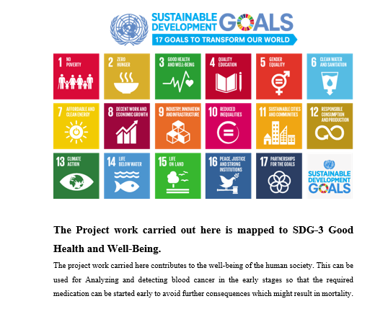
Project work mapping with SDG

Slide 18
Project work mapping with SDG
The project aligns with several Sustainable Development Goals (SDGs) by utilizing technology to foster economic growth, resilience, and empowerment.
SDG 1: No Poverty is addressed by helping communities like Ima Market recover after disasters, providing e-commerce solutions for women breadwinners, and creating job opportunities through tech-driven platforms.
For SDG 5: Gender Equality, the project empowers women economically, particularly in women-led businesses, supporting their independence and success.
In alignment with SDG 8: Decent Work and Economic Growth, the platform promotes inclusive growth by offering IT professionals meaningful work opportunities and enabling disaster-resilient economic solutions.
The project also contributes to SDG 9: Industry, Innovation, and Infrastructure by fostering innovation through tech solutions that create scalable, resilient infrastructure, accessible to all through open-source contributions.

Slide 19
Project work mapping with SDG
For SDG 11: Sustainable Cities and Communities, the platform helps communities rebuild and become more resilient, reducing vulnerability to disruptions.
By focusing on SDG 13: Climate Action, the project provides disaster-resilient systems that mitigate climate change impacts, helping communities adapt to floods, earthquakes, and other disruptions.
Lastly, SDG 17: Partnerships for the Goals is integral, as the project brings together financial and skilled resources to strengthen global partnerships for sustainable development.

Slide 20
Thank You

